Slide 1
Microwave and Satellite Communication
CSTE 3203

Slide 2
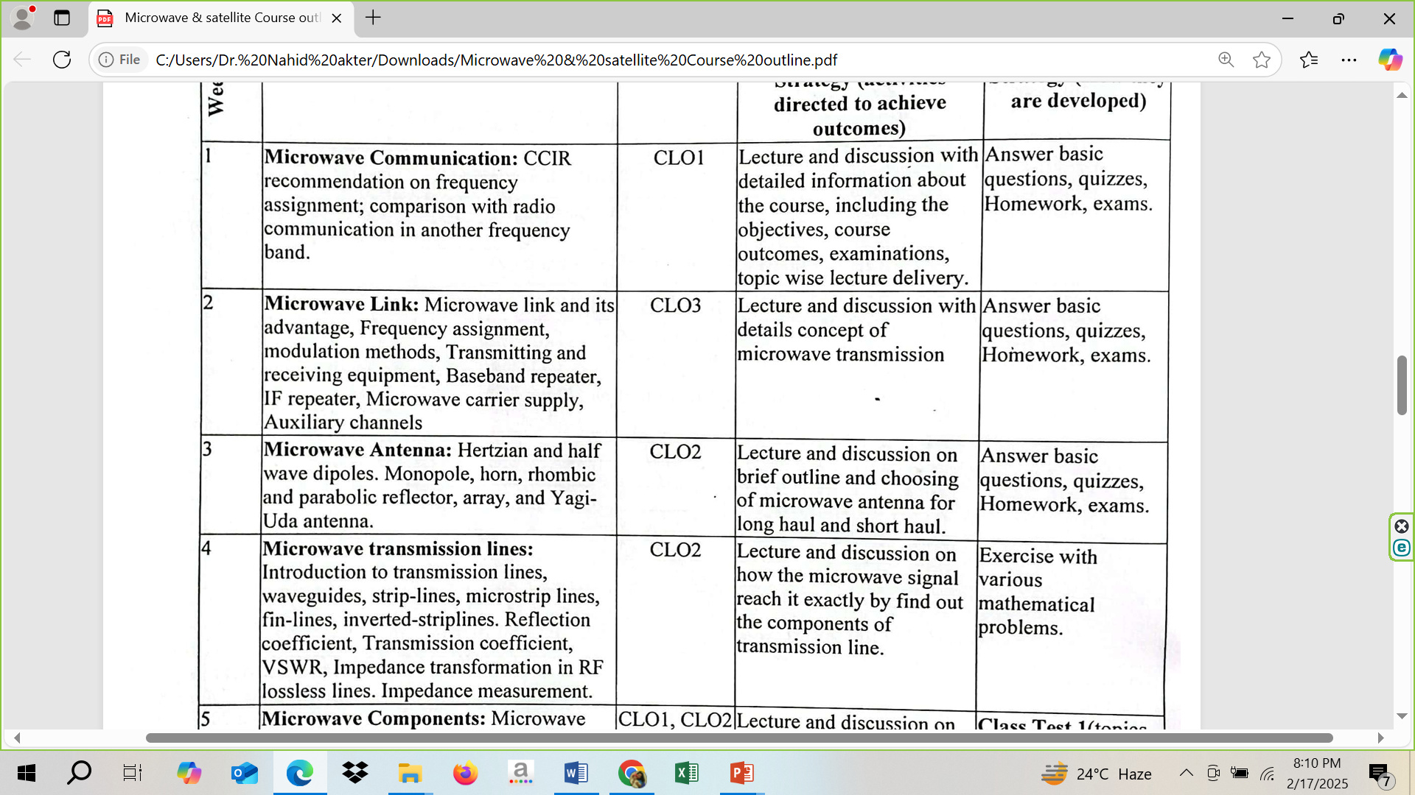

Slide 3
Antenna Fundamentals

Slide 4
Antenna
An Antenna is a transducer, which converts electrical power into electromagnetic waves and vice versa.
An Antenna can be used either as a transmitting antenna or a receiving antenna.
A transmitting antenna is one, which converts electrical signals into electromagnetic waves and radiates them. A receiving antenna is one, which converts electromagnetic waves from the received beam into electrical signals.
Note: In two-way communication, the same antenna can be used for both transmission and reception.

Slide 5
Radiation Mechanism
The sole functionality of an antenna is power radiation or reception. Antenna (whether it transmits or receives or does both) can be connected to the circuitry at the station through a transmission line. The functioning of an antenna depends upon the radiation mechanism of a transmission line.

Slide 6
Transmission Line
A conductor, which is designed to carry current over large distances with minimum losses, is termed as a transmission line.
For example, a wire, which is connected to an antenna. A transmission line conducting current with uniform velocity, and the line being a straight one with infinite extent, radiates no power.

Slide 7
Transmission Line
If the power has to be radiated (though the current conduction is with uniform velocity) the wire or transmission line should be bent, truncated or terminated.
The device or tube, if bent or terminated to radiate energy, then it is called as waveguide. These are especially used for the microwave transmission or reception.

Slide 8
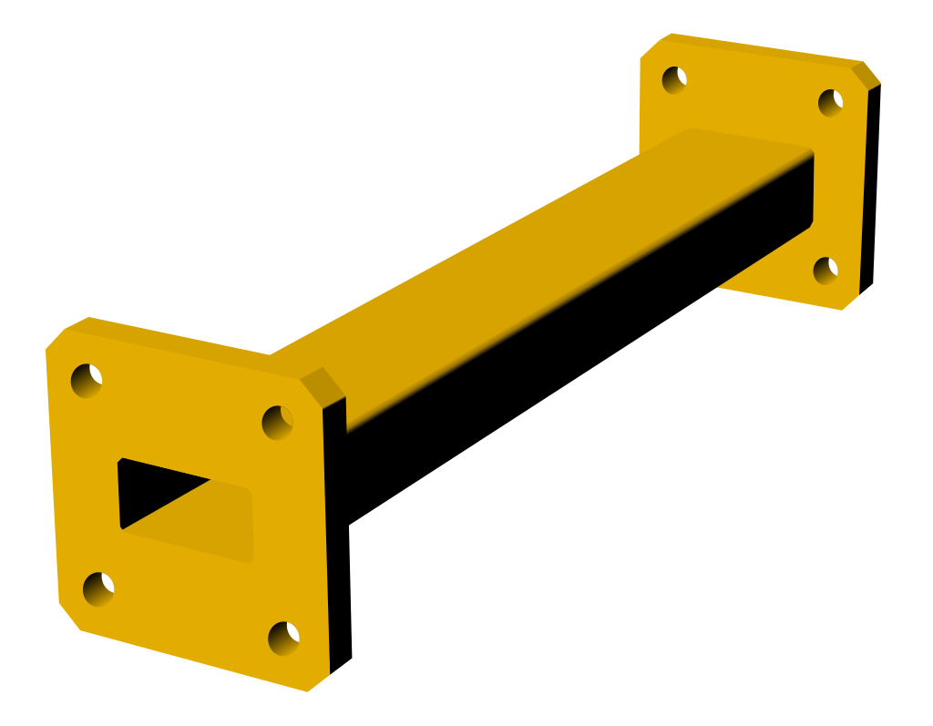
WG 17 UBR 120

Slide 9
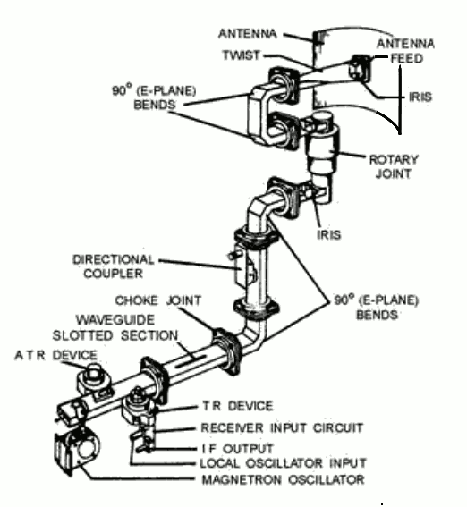

Slide 10
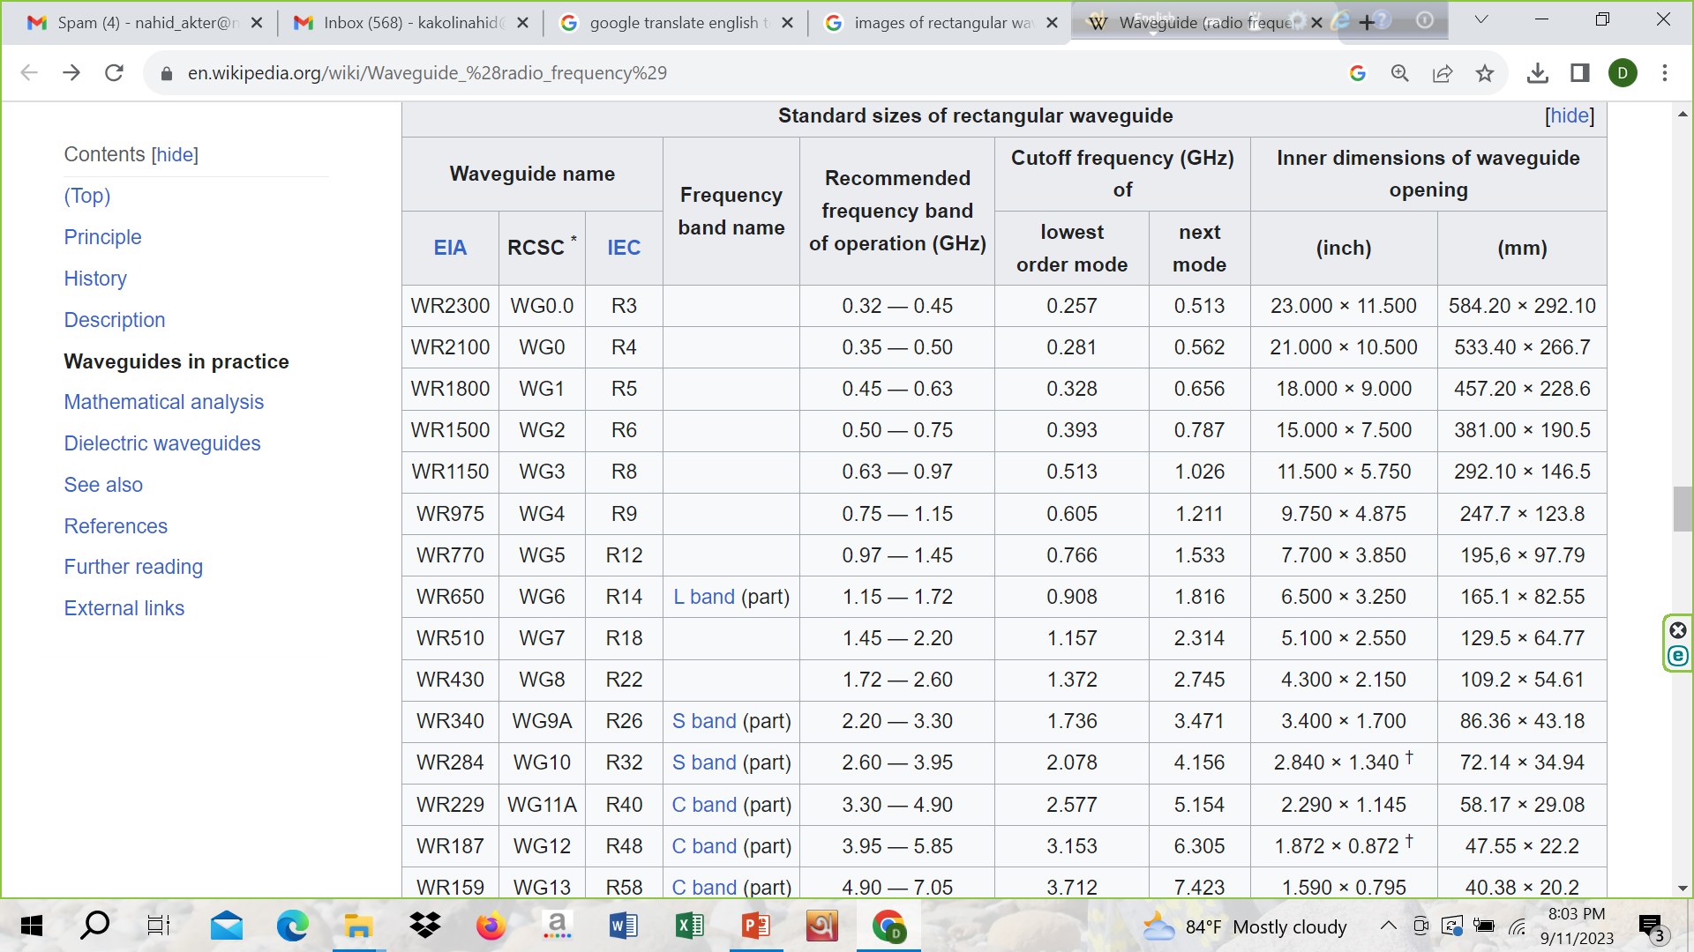

Slide 11
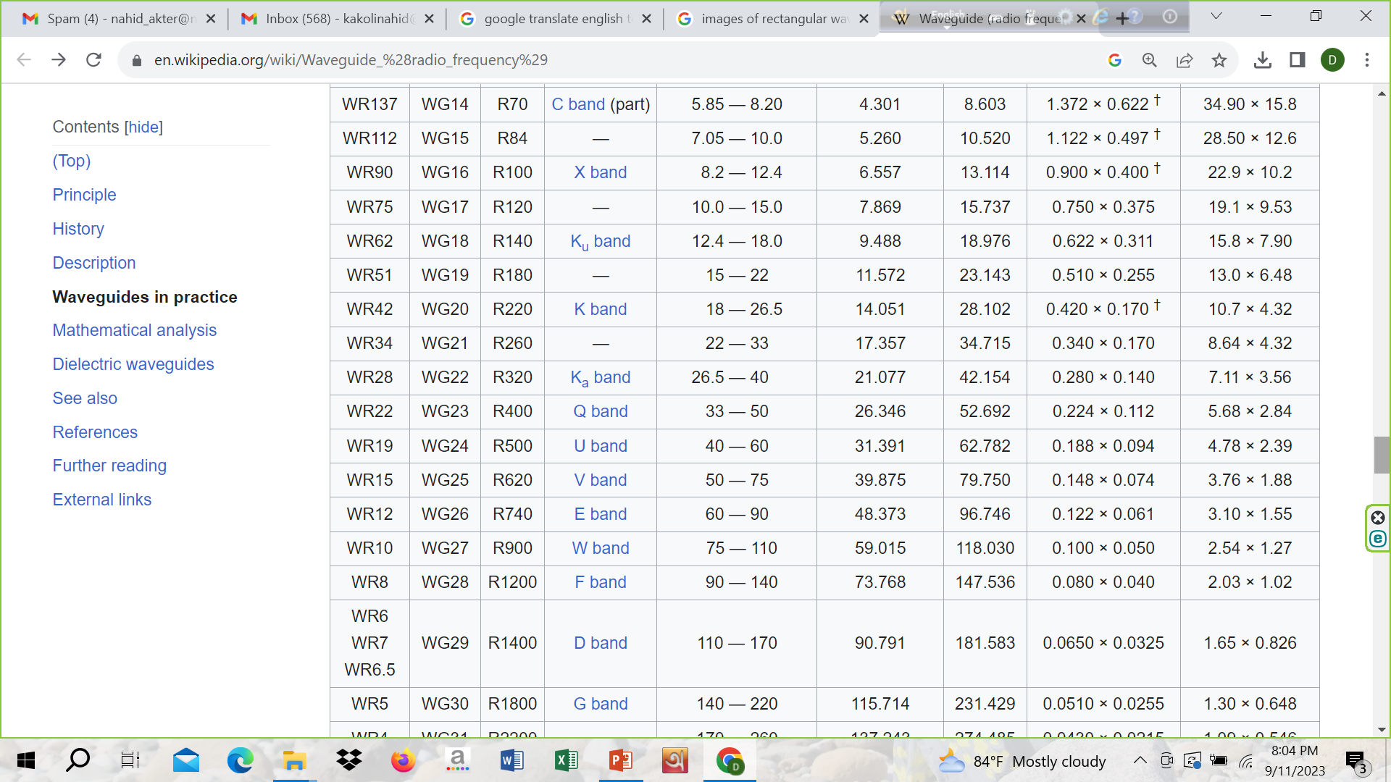

Slide 12
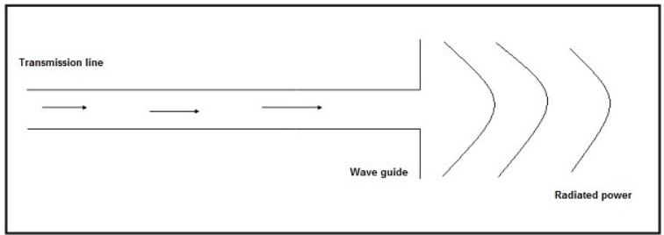
Radiation Mechanism
The above diagram represents a waveguide, which acts as an antenna. The power from the transmission line travels through the waveguide which has an aperture, to radiate the energy.

Slide 13
Frequency of operation
The types of antennas depends on according to the frequency of operation such as VLF, LF, MF, HF, VHF, UHF…..microwave, radio wave etc.

Slide 14
Mode of Applications
The types of antennas depends on according to the modes of applications:
Point-to-point communications
Broadcasting applications
Radar communications
Satellite communications

Slide 15
Basic Parameters

Slide 16
Antenna Parameters
Frequency
Wavelength
Impedance matching
VSWR & reflected power
Bandwidth
Percentage bandwidth
Radiation intensity

Slide 17
Other Parameters

Slide 18
Directivity
Gain
Aperture efficiency
Antenna efficiency

Slide 19
Radiation Field Pattern

Slide 20
Field Pattern
The field distribution can be quantifying in terms of field intensity is referred to as field pattern.
That means, the radiated power from the antenna when plotted, is expressed in terms of electric field E. Hence, it is known as field pattern. If it is quantified in terms of power (W), then it is known as power pattern.

Slide 21
Field Pattern
The graphical distribution of radiated field or power as a function of
spatial angles (θ, Ø) for far-field.
spatial angles (θ, Ø) and radial distance(r) for near-field.

Slide 22
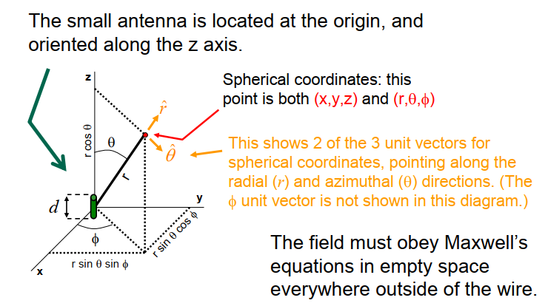
Coordinate System

Slide 23
Near/Far Field Pattern
Near Field:
The field, which is nearer to the antenna, is called as near-field. It has an inductive effect and hence it is also known as inductive field, though it has some radiation components.
Far field:
The field, which is far from the antenna, is called as far-field. It is also called as radiation field, as the radiation effect is high in this area. Many of the antenna parameters along with the antenna directivity and the radiation pattern of the antenna are considered in this region only.

Slide 24
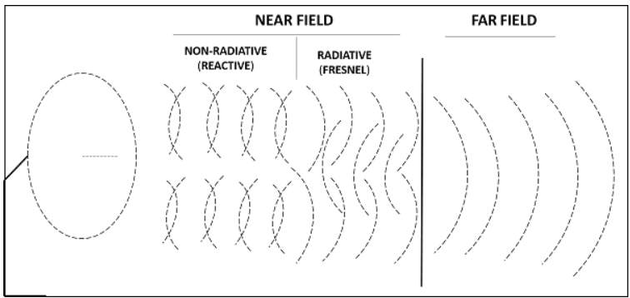
Field Pattern

Slide 25
Field Pattern
The field, which is very near to the antenna is reactive near field or non-radiative field where the radiation is not pre-dominant.
The region next to it can be termed as radiating near field or Fresnel’s field as the radiation predominates and the angular field distribution, depends on the physical distance from the antenna.
The region next to it is radiating far-field region. In this region, field distribution is independent of the distance from antenna. The effective radiation pattern is observed in this region.

Slide 26
Radiation Pattern
The energy radiated by an antenna is represented by the Radiation pattern of the antenna. Radiation Patterns are diagrammatical representations of the distribution of radiated energy into space, as a function of direction.
This is a mathematical function of radiation properties of the antenna represented as a function of spherical co-ordinates, E (θ, Ø) and H (θ, Ø).

Slide 27
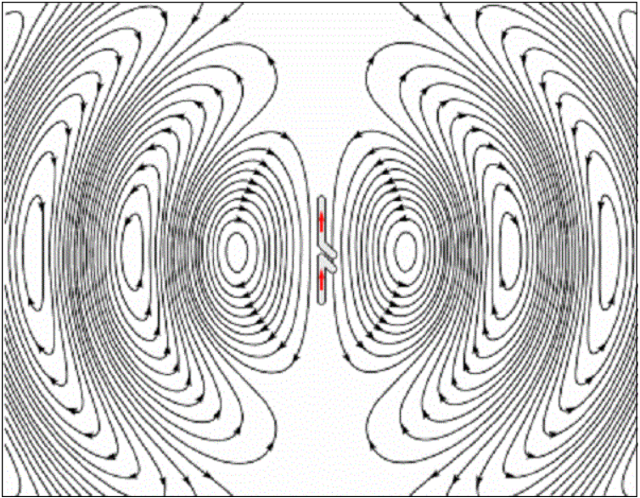
Radiation Pattern

Slide 28
Radiation Pattern
The above figure shows radiation pattern of a dipole antenna. The energy being radiated is represented by the patterns drawn in a particular direction. The arrows represent directions of radiation.

Slide 29
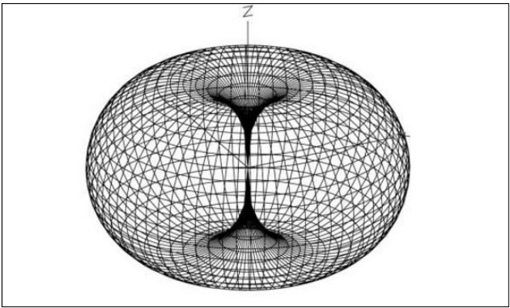
Radiation Pattern in 3D
The given figure is an Omni directional radiation pattern. This indicates the three co-ordinates (x, y, z).

Slide 30
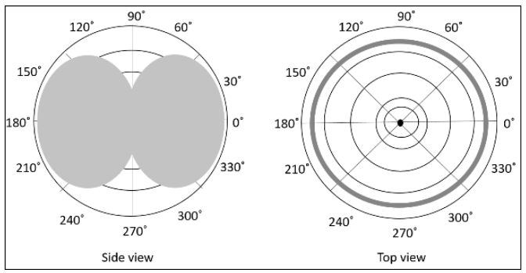
Radiation Pattern in 2D

Slide 31
Radiation Pattern 2D
Two-dimensional pattern can be obtained from three-dimensional pattern by dividing it into horizontal and vertical planes. These resultant patterns are known as Horizontal pattern and Vertical pattern respectively.

Slide 32
Types of Radiation patterns
The common types of Radiation patterns are:
Omni-directional pattern (also called non-directional pattern): The pattern usually has a doughnut shape in three-dimensional view. However, in two-dimensional view, it forms a figure-of-eight pattern.
Pencil-beam pattern: The beam has a sharp directional pencil shaped pattern.
Fan-beam pattern: The beam has a fan-shaped pattern.
Shaped beam pattern: The beam, which is non-uniform and patternless is known as shaped beam.

Slide 33
Isotropic Radiation
Isotropic radiation is the radiation from a point source, radiating uniformly in all directions, with same intensity regardless of the direction of measurement.
or
If the radiation is equal in all directions, then it is known as isotropic radiation.

Slide 34
Isotropic Radiation
The point source is an example of isotropic radiator. However, this isotropic radiation is practically impossible, because every antenna radiates its energy with some directivity.
The isotropic radiation is nothing but Omni-directional radiation.
It has a doughnut-shaped pattern when viewed in 3D and a figure-of-eight pattern when viewed in 2D.

Slide 35
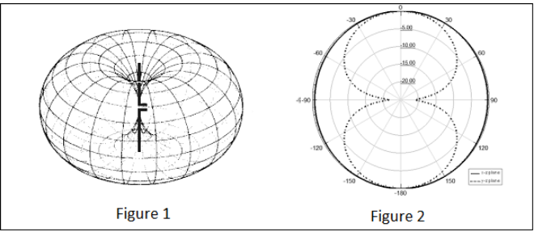
Doughnut-shaped pattern and a figure-of-eight pattern

Slide 36
Directivity
“The ratio of maximum radiation intensity of the subject antenna to the radiation intensity of an isotropic or reference antenna, radiating the same total power is called the directivity.”
“The ratio of radiation intensity in a given direction from an antenna to the radiation intensity averaged over all directions, is termed as directivity.”
If that particular direction is not specified, then the direction in which maximum intensity is observed, can be taken as the directivity of that antenna.
The directivity of a non-isotropic antenna is equal to the ratio of the radiation intensity in a given direction to the radiation intensity of the isotropic source.

Slide 37
Directivity
The radiation intensity is focused in a particular direction, while it is transmitting or receiving. Hence, the antenna is said to have its directivity in that particular direction.
Directivity=Maximum radiation intensity of subject antenna/ Radiation intensity of an isotropic antenna

Slide 38
Directivity
The radiated power is a function of the angular position and the radial distance from the circuit. Hence, it is expressed by considering both the terms θ and Ø.
D= Ø(θ, Ø)_{max}(from subject antenna)/ Ø₀(from an isotropic antenna)
Where
Ø(θ, Ø)_{max} is the maximum radiation intensity of subject antenna.
Ø₀is the radiation intensity of an isotropic antenna (antenna with zero losses).

Slide 39
Gain
“Gain of an antenna is the ratio of the radiation intensity in a given direction to the radiation intensity that would be obtained if the power accepted by the antenna were radiated isotropically.”
Simply, gain of an antenna takes the directivity of antenna into account along with its effective performance.

Slide 40
Gain
The term antenna gain describes how much power is transmitted in the direction of peak radiation to that of an isotropic source.
Gain is usually measured in dB.
Unlike directivity, antenna gain takes the losses that occur also into account and hence focuses on the efficiency.

Slide 41
Gain
The equation of gain, G is as shown below.
G=η_{e}D = P_{rad}/P_{input} *Ø(θ, Ø)_{max}/ Ø₀
Where,
G is gain of the antenna.
η_{e} is the antenna’s efficiency.
D is the directivity of the antenna.
The unit of gain is decibels or simply dB.

Slide 42
Isotropic Radiator
Gain:
The isotropic radiator in terms of dB, it can be called as 0dB gain (zero loss or lossless).

Slide 43
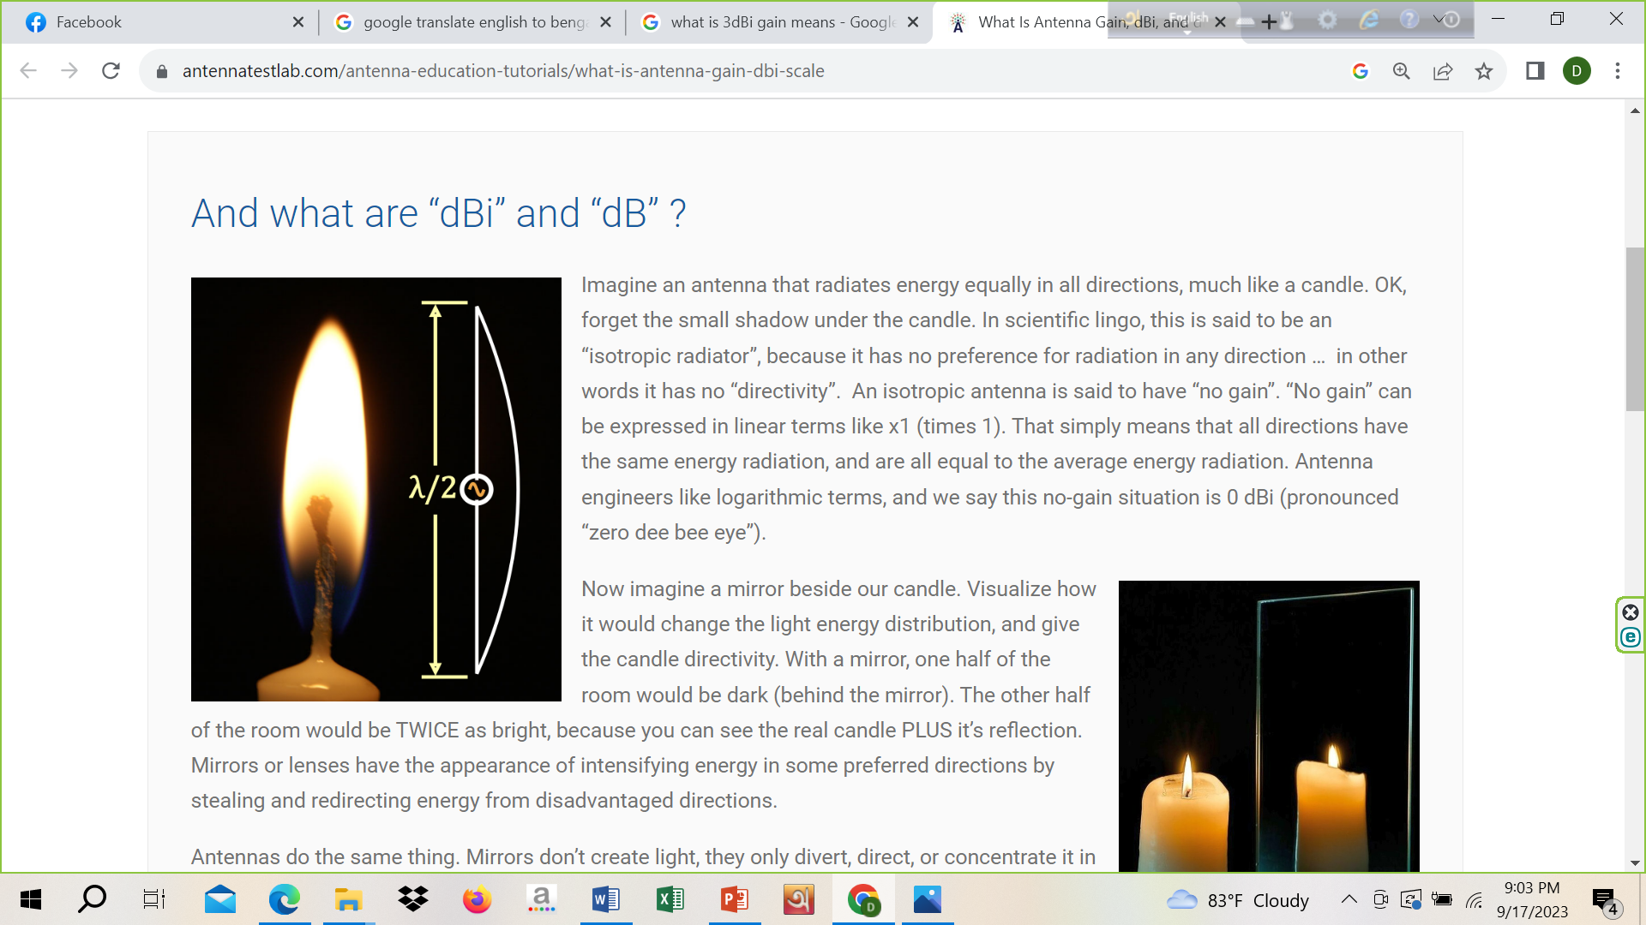

Slide 44
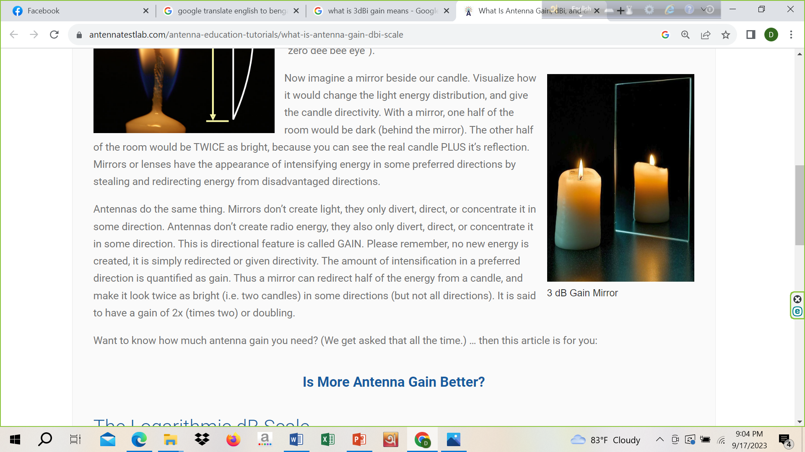

Slide 45

